Slide 1

Capstone 1: Team Compsognathus
John Clos, Ling Lu and Yuman Wu

Slide 2

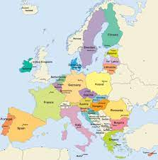
Hypothesis:
Higher education rates correlates with increased life expectancy
Is there a difference between males and females?
Does the education rate between countries influence their life expectancy?

Slide 3
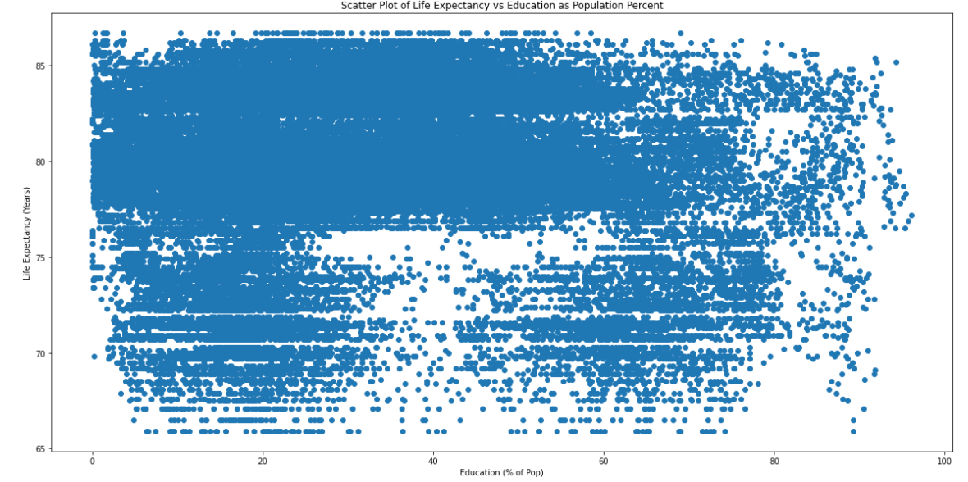
Correlation between Life Expectancy and Education for European Union Countries
Notes:
The plot of all data doesn’t show us much.

Slide 4
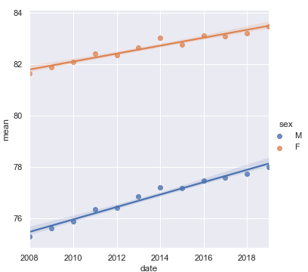
Life Expectancy by Year
Notes:
Life expectancy is improving each year

Slide 5
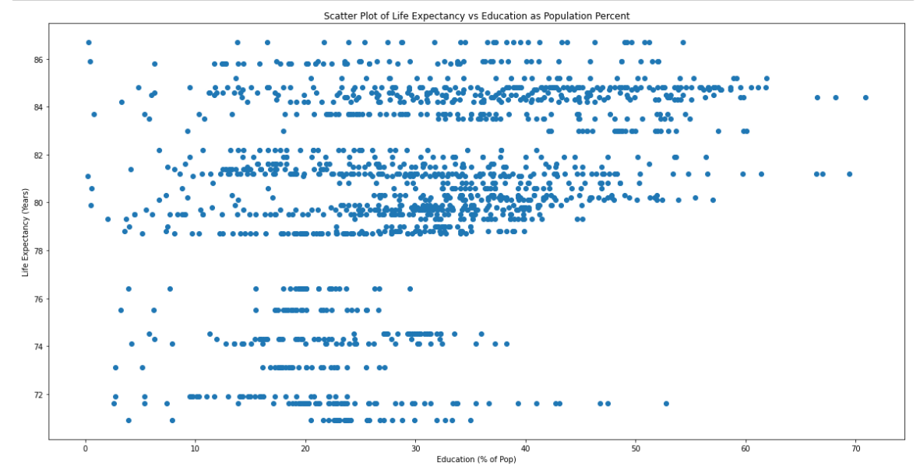
Correlation between Life Expectancy and Education (All Data) for 2019
Notes:
When we just show the data for 2019 though, we can see that the life expectancy is much better for higher education rates except for a small group of data.

Slide 6
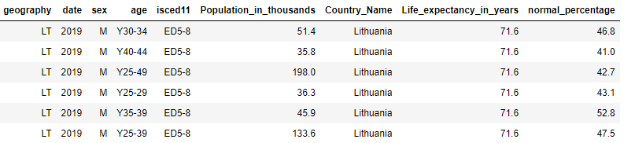
Data in Previous Slide with High Education Rates (>40% ED5-8) and Lower Life Expectancy (<77 years)
Notes:
So if we filter the data for this range, we see that it is for Lithuania for the the younger age ranges.

Slide 7
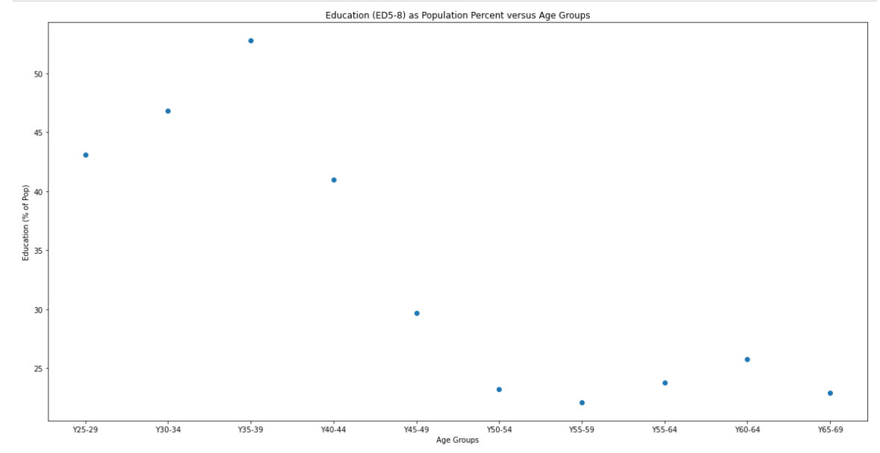
Correlation between Life Expectancy and Education (ED5-8) for Lithuania 2019
Notes:
So if we plot the data for Lithuania by age ranges, we see that the higher education rates are much better at the lower age ranges than the upper ones.
Maybe the improvement in education rates have not had a chance to improve the life expectancy for Lithuania.

Slide 8
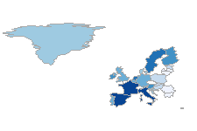
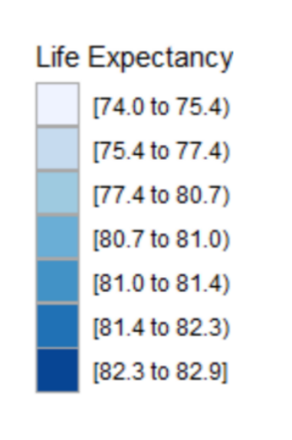
Choropleth Map of Life Expectancy for European Union Countries
Notes:
Eastern Europe definitely shows lower life expectancy than Western Europe

Slide 9
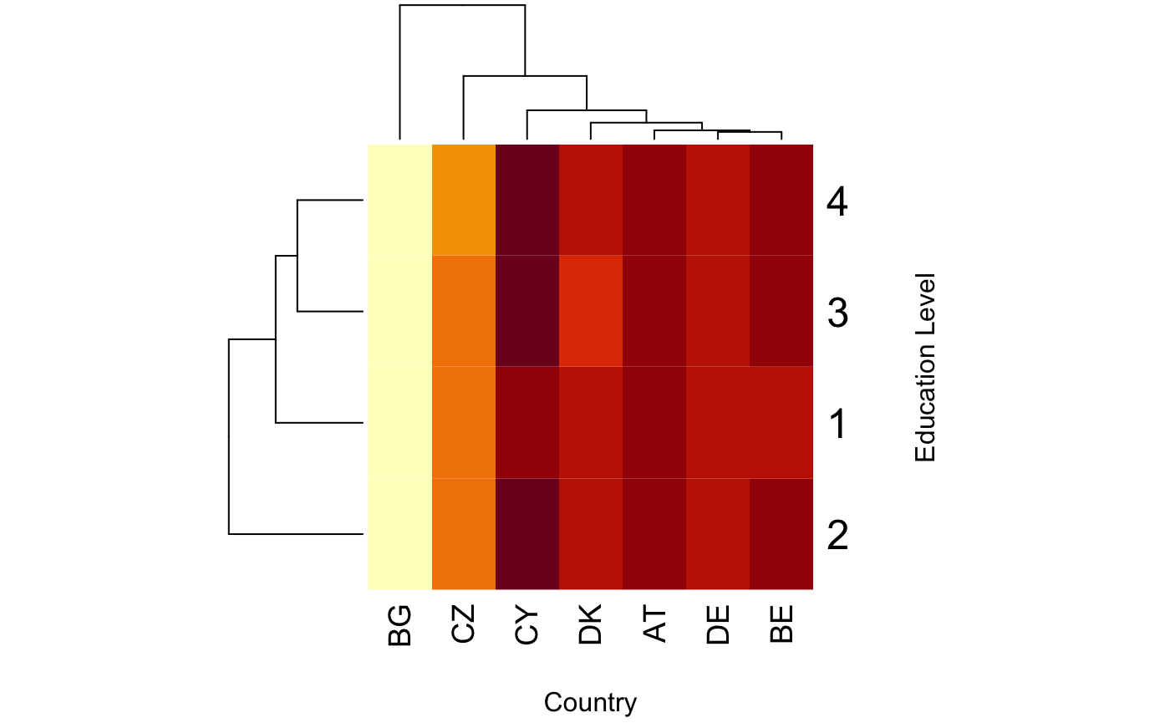
Heatmap with Education VS Life Expectancy
As number of rows increase, the life expectancy
Has increased

Slide 10
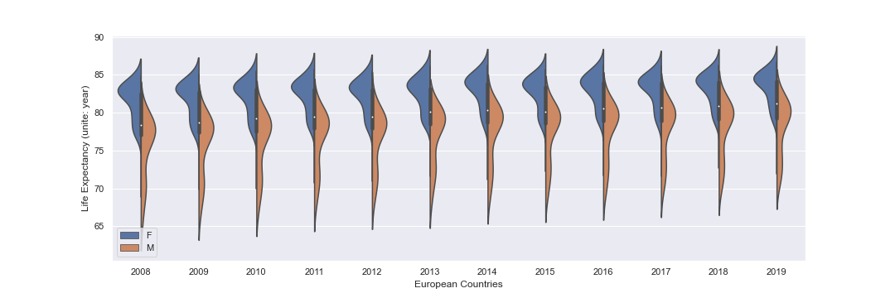
Violin Plots of Life Expectancy by Year
Notes:
Plots show that the distribution for women is shifted higher for life expectancy than men and also the range for men extends much lower

Slide 11
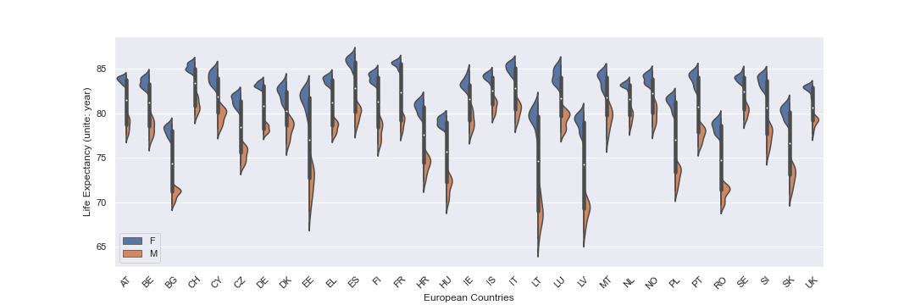
Violin Plots of Life Expectancy by Country
Notes:
We can see that men always have a lower life expectancy than women for each country

Slide 12
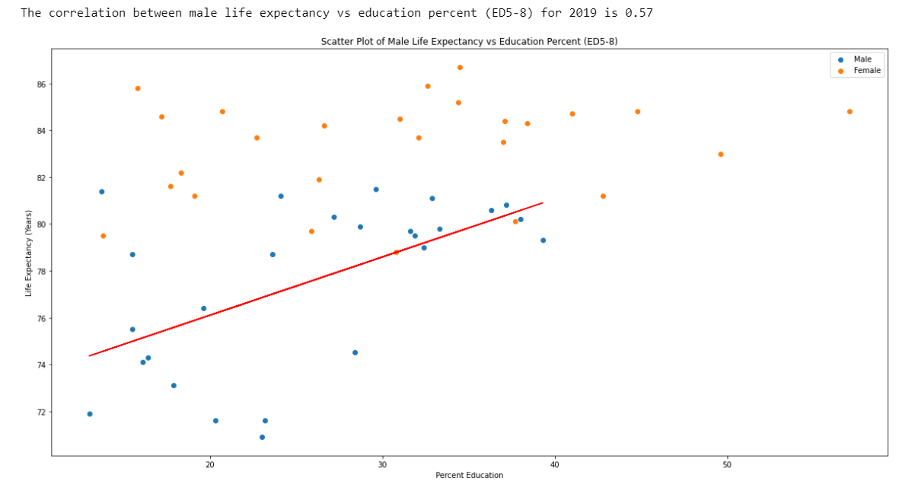
Correlation between Life Expectancy and Education (ED5-8) for 2019
Notes:
This shows that there isn’t a correlation for women with education, but for men there is a slight correlation. The reason might be that the jobs that women with lower education do not affect their health, but jobs that men have with lower education have a bad influence on their health.

Slide 13
Conclusions:
Higher education rates do correlate with increased life expectancy, but…
There is a difference when it comes to males and females.
The education rate between countries does have a slight influence on male life expectancy, especially at the higher rates.

